Slide 1

PCWG
TI measurements offshore for power curve verification
and wind resource assessment
Colorado 6 October 2014
MOVING ENERGY FORWARD

Slide 2
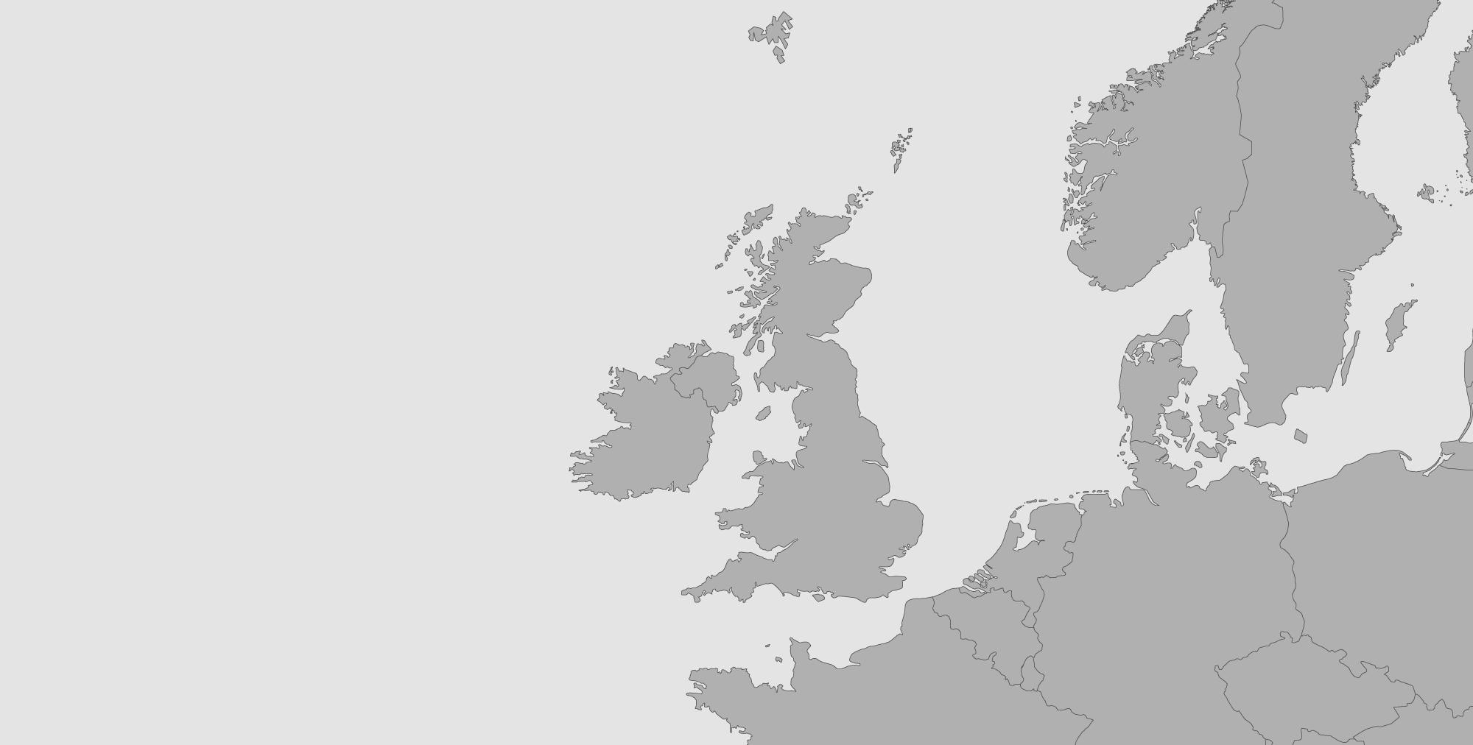








DONG Energy is one of the leading energy groups in Northern Europe
Our business is based on procuring, producing, distributing and trading in energy and related products in Northern Europe.
DONG Energy has 6,500 employees and is headquartered in Denmark.
Exploration & Production
Wind Power
Thermal Power
Customers & Markets

Slide 3
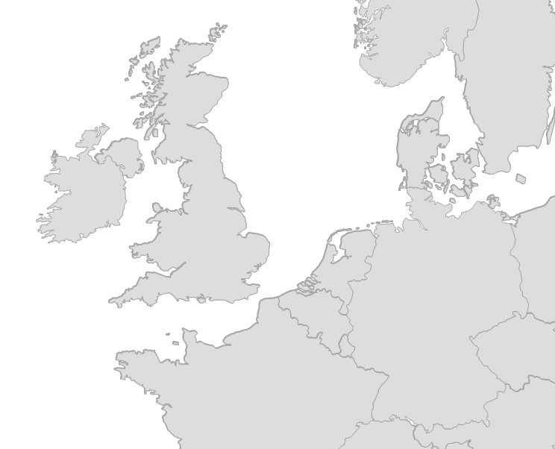







Wind Power
Offshore projects in operation, under construction and development
Principal activity
Development, construction and operation of offshore wind farms
Market position
Market leader in offshore wind, has built 35% of European capacity
Strong pipeline of projects in lead-up to 2020
Strategic targets for 2020
Installed offshore wind capacity (gross installed): 6.5 GW
Reducing offshore wind Cost of Electricity to below EUR 100/MWh³
Outer Solway
Anholt
Walney Ext.
Westermost Rough
Horns Rev 2
Tunø knob
Middelgrunden
Northern Ireland
Walney 1+2
Horns Rev 1
WoDS
Hornsea Heron
Vindeby
Avedøre Holme
Barrow
Hornsea Njord
Race bank
Nysted
Lincs
Gode Wind 3+4
Burbo Bank Ext.
Gode Wind 1+2
Borkum Riffgrund 1
Gunfleet Sands 1+ 2
Borkum Riffgrund 2
Burbo Bank
Den Helder
Borkum Riffgrund West 1
London Array 1
Breeveertien
West Rijn
Fécamp
In operation
Courseulles-sur-Mer
Under construction
Under development
Saint-Nazaire

Slide 4
TI measurements offshore for power curve verification
Relevance of TI measurements in the inner/outer range concept
Power curve verification offshore: two beam nacelle LIDAR
TI based on two beam nacelle LIDAR
Readiness from 3rd party independent testers in the use of nacelle LIDAR
Characterization of ambient offshore turbulence intensity in Northern Europe

Slide 5
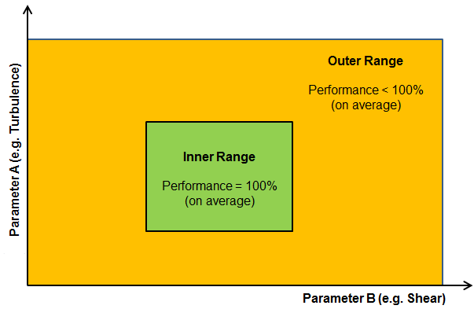
TI measurements in the inner/outer range concept
Inner Range: the range of conditions for which one can expect to achieve an Annual Energy Production (AEP) of 100% (relative to a reference power curve).
Outer Range: the range of conditions for which one can expect to achieve an AEP of less than 100%. Stated another way the outer range is the range of all possible conditions excluding those in the inner range. It is envisaged that suppliers may offer some level of reduced warranty for the outer range

Slide 6
TI measurements in the inner/outer range concept
TI measurement as a good proxy for stability offshore
TI for offshore site classification (second part)
Focus on the inner range for power curve guarantees
Being able to measure "type B" performance issues (inner to WTG)
Eventual use other measurements to monitor atmospheric stability
(ground based /floating LIDARs / sea surface temperature)
Power curve test as a dialogue instrument for performance improvements
with WTG supplier

Slide 7
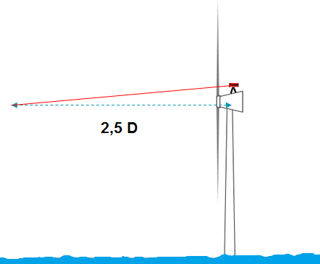
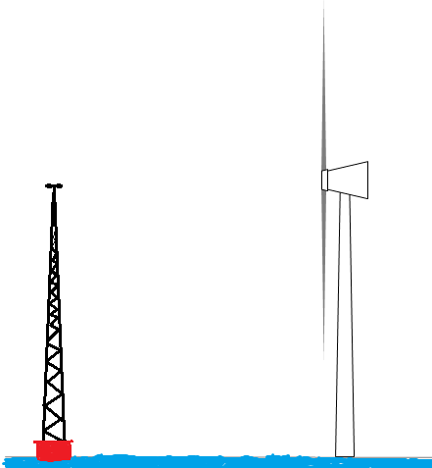
Power curve verification offshore: two beam nacelle LIDAR
Nacelle-based LIDAR
IEC61400-12-1 Ed.1
Cost effective solution
Very costly offshore !

Slide 8
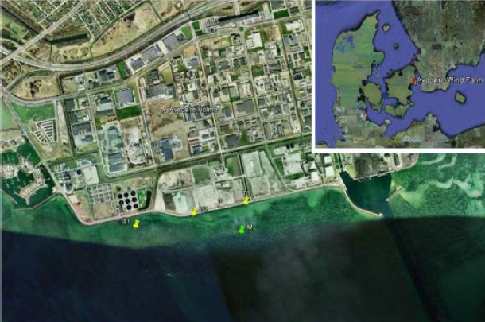
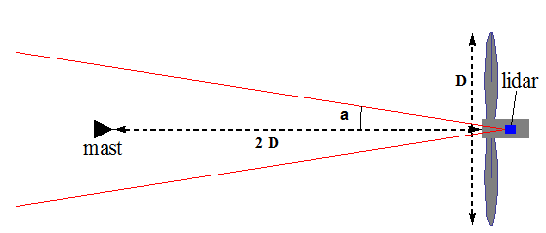
Power curve verification offshore: two beam nacelle LIDAR
EUDP project lead by DTU: demonstration test at Avedøre

Slide 9
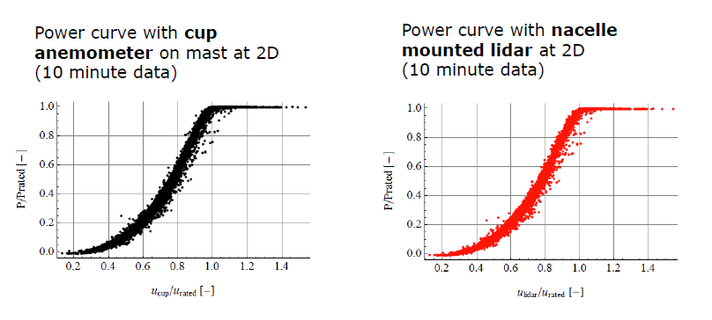
Power curve verification offshore: two beam nacelle LIDAR
Comparison of results as outcome of the EUDP project lead by DTU
DTU Wind Energy E-0016

Slide 10
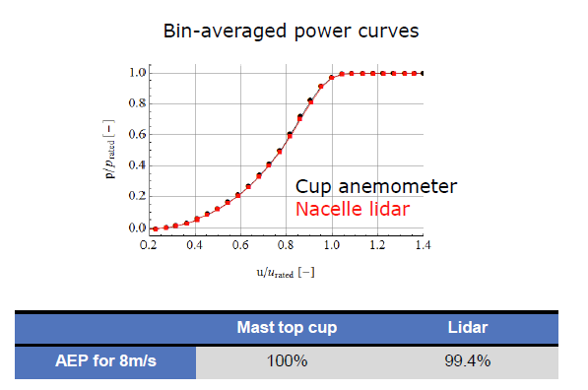
Power curve verification offshore: two beam nacelle LIDAR
Comparison of results as outcome of the EUDP project lead by DTU
DTU Wind Energy E-0016

Slide 11
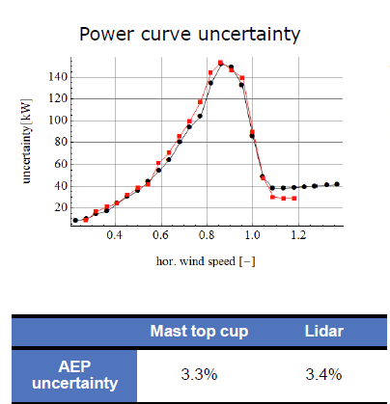
TI based on two beam nacelle LIDAR
Comparison of results as outcome of the EUDP project lead by DTU
The lidar calibration uncertainty
2) The uncertainty due to the terrain orography
3) The uncertainty related to the measurement height (if this one goes out of the range hub height +/- 2.5%)
4) The uncertainty of the tilt inclinometers
DTU Wind Energy E-0016

Slide 12
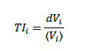
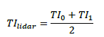
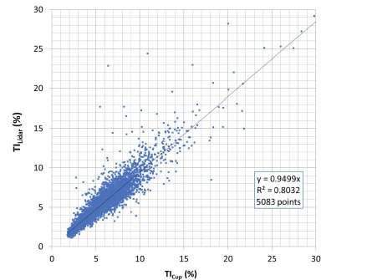
TI based on two beam nacelle LIDAR
Formulation use for computing TI with a two beam nacelle LIDAR
Arithmetic average of the TI of each beam :
DTU Wind Energy E-0016
Notes:
Turbulence intensity on each beam is defined as the standard deviation dV^{i} of each beam’s wind speed (i=0 or 1) divided by the average beam radial wind speed
the 10 minute average radial wind speeds are noted <V⁰> (for the left-hand line of sight when looking forward from behind the lidar optical head) and <V¹> (for the right-hand line of sight).

Slide 13
3rd party independent testers readiness
Readiness¹ is confirmed by:
5 different independent testers having participated in bids for testing services
3 different independent testers have been actively involved in the nacelle LIDAR power curve analysis
Lack of IEC standard does not compromise quality
Lack of IEC coverage may compromise acceptance from non technically well informed agents in our value change
¹ EUDP program was published in January 2013

Slide 14
TI measurements offshore for power curve verification
Relevance of TI measurements in the inner/outer range concept
Power curve verification offshore: two beam nacelle LIDAR
TI based on two beam nacelle LIDAR
Readiness from 3rd party independent testers in the use of nacelle LIDAR
Characterization of ambient offshore turbulence intensity in Northern Europe

Slide 15

Characterization of Ambient Offshore Turbulence Intensity from Analysis of Nine Offshore Meteorological Masts in Northern Europe
Masters Thesis in collaboration with Nicolai Nygaard & Miriam Marchante Jiménez at DONG Energy and Rozenn Wagner and Ameya Sathe at DTU Risø Wind Energy.
Daniel Pollak
European Wind Energy Masters Program 2014
MSc Wind Energy Engineering –Tech. Univ. of Denmark 2014
MSc Engineering Wind Physics – Univ. of Oldenburg 2014
BSc Meteorology – Penn State 2011
NCAR/CU Intern Summers 2009-2012

Slide 16
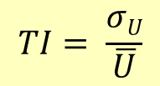
Motivation & Goals
Turbulence Intensity (TI)
The degree of fluctuations about the mean wind speed within wind field
$$TI= \frac{σU}{\overline{U}}$$
Why TI is Important to Understand
Fatigue loads on turbine structure dependent on TI → knowledge of TI fosters optimal turbine design
To properly model wakes (lower turbulence results in slower wake recovery and more wake losses) → this work provides insight and could be used as input in future models
Of value to both research and industry
Data Availability
9 offshore met masts throughout Northern Europe
Scale hitherto not examined
Notes:
Ambient Turbulence Intensity

Slide 17
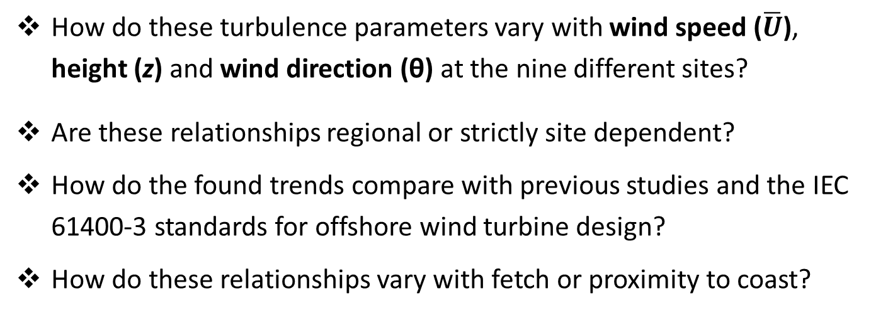
Thesis Research Questions
Turbulence Parameters
Discussed
σ_{U} – wind speed standard deviation
TI – ambient turbulence intensity
How do these turbulence parameters vary with wind speed ($\overline{U}$), height (z) and wind direction (θ) at the nine different sites?
Are these relationships regional or strictly site dependent?
How do the found trends compare with previous studies and the IEC 61400-3 standards for offshore wind turbine design?
How do these relationships vary with fetch or proximity to coast?
Notes:
Could say why these four parameters are described.

Slide 18
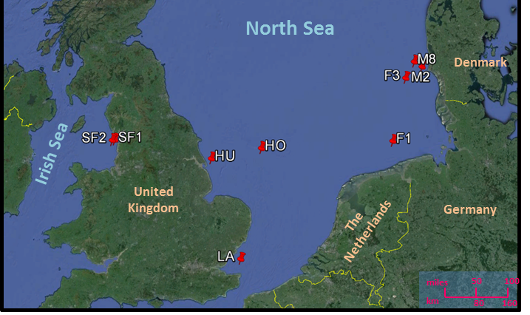
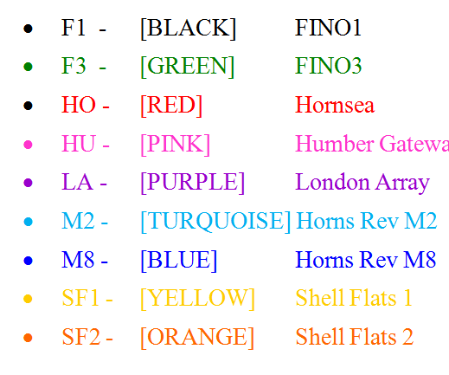
The Data – 9 Met Masts
Prevailing Westerlies
Prevailing Westerlies
1-5 years of data per mast between 2005-2013 (except M2)
A wealth of data with speed and direction data available at numerous heights
9 masts with 74 sets of wind speed data (1-3 obs per height)
Ranging from 7-111km from nearest land
10 minute data – analyzed in yearly periods to avoid intro of seasonal bias
Filtering criteria implemented; mast shadow corrected

Slide 19
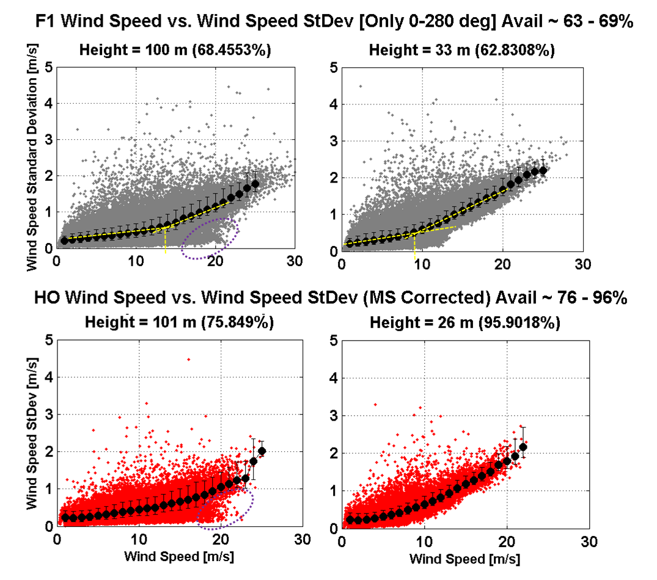
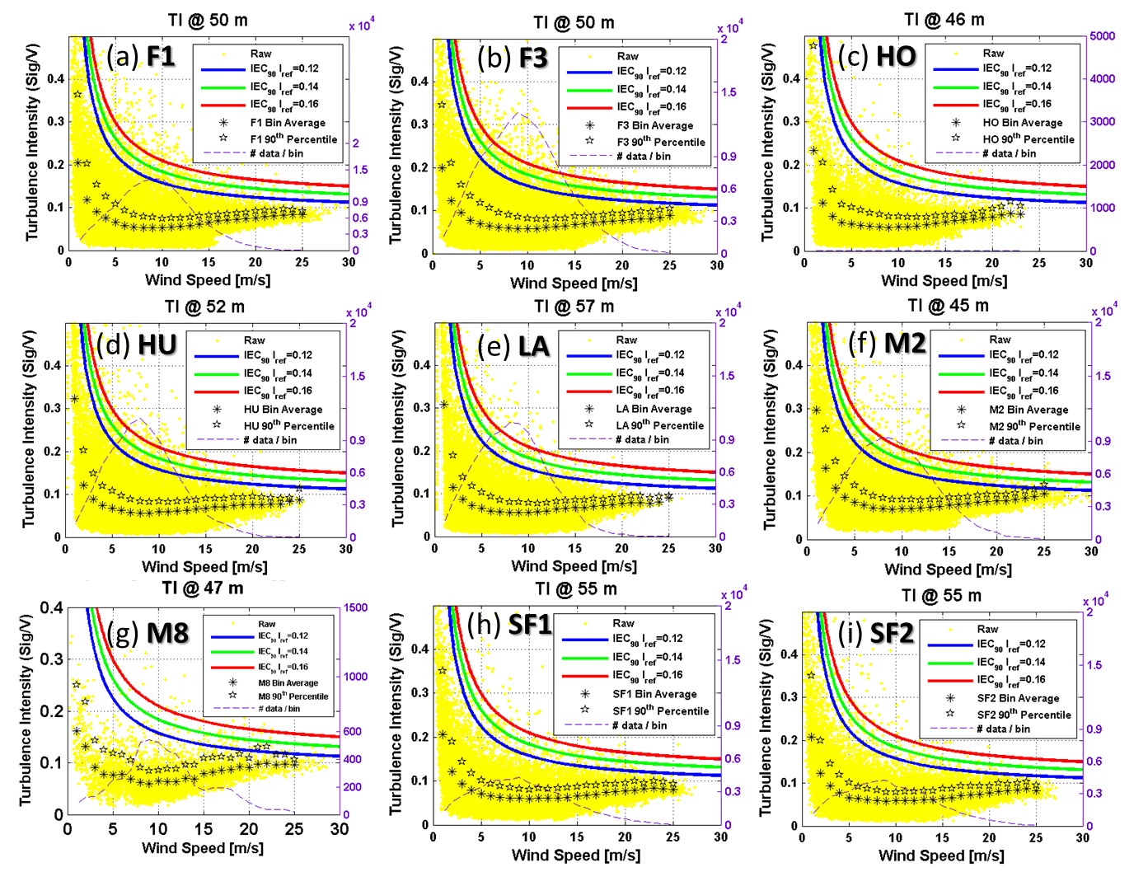
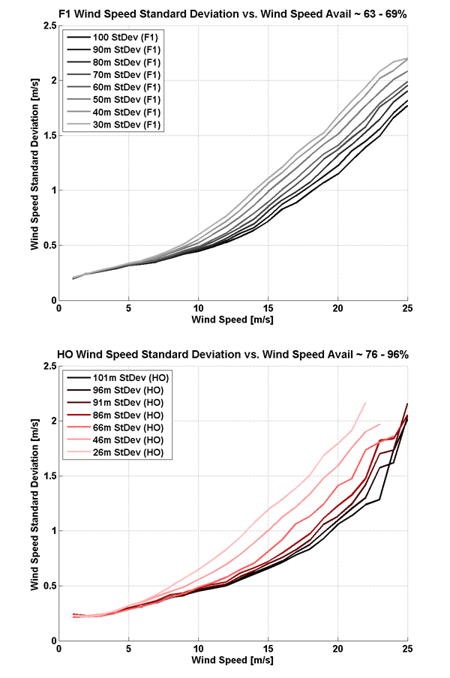
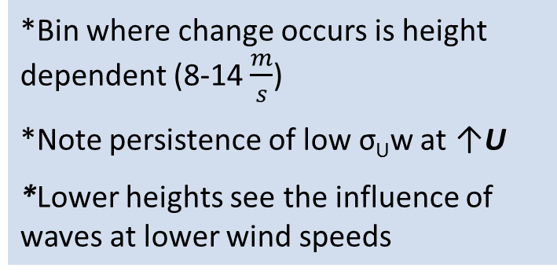
σ_{U} vs Speed - Scatterplots
*IEC 61400-3 states that σ_{U} increases linearly with height.
*Not the case as slope changes around transition from thermal to wave-driven turbulence
Mechanical
Thermal
*Bin where change occurs is height dependent (8-14 $\frac{m}{s}$)
*Note persistence of low σ_{U}w at ↑U
*Lower heights see the influence of waves at lower wind speeds
Thermal
Mechanical
Notes:
*Change more noticeable at F1

Slide 20
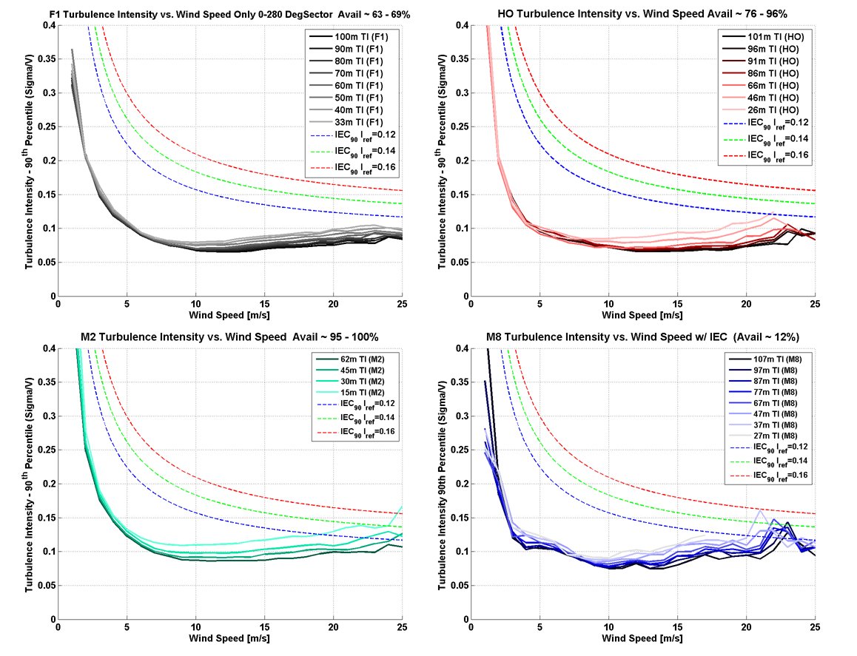
TI vs Speed - Scatterplots
F1
Thermal
Mechanical
*IEC states that TI monotonically decreases, not the case offshore
*Change in slope of σ_{U} corresponds to minimum in TI curve due to transition between turbulence generating sources. (Height dependent : 8-14 m/s)
* More scatter with thermally driven turbulence: vast differences between TI observed in stable versus unstable conditions
*Decreasing TI with increasing z; further from air-sea interface

Slide 21
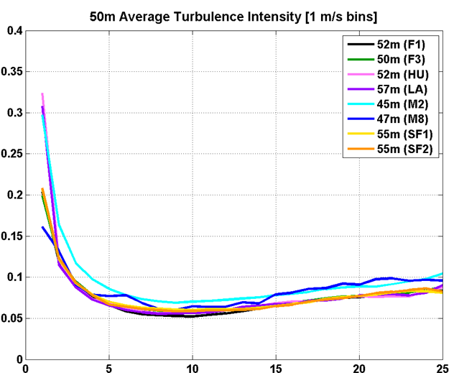
All Mast Comparison – TI vs Speed
Very similar trends, especially at 50, 70 and 80m. Less agreement at 30m
Same closeness observed with σ_{U}
Nearly universal relationship universal in Northern Europe when averaging over all wind directions, especially at high U
50m
Turbulence Intensity
Wind Speed (m/s)

Slide 22
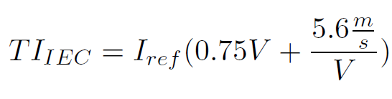
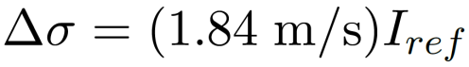
IEC 61400-3 Standard: Discrepancies Found
Design Requirements for Offshore Wind Turbines
(Based on Onshore IEC 61400-1 Standard)
IEC 61400-3 Standard
* σ_{U}, σ_{σU} increase w/ height @ ↑U
* σ_{U} experiences change in slope w/ increasing U (turb transition)
* σ_{σU} does vary some with U
* TI decreases until a height-dependent turbulence transition point after which TI increases
* Values for Δσ much larger and height-dependent
* σ_{U} is unchanging with height
* σ_{U} increases linearly with height
* σ_{σU} invariant w/ height & U
* TI monotonically decreases w/ increasing wind speed
* TI unchanging with height
* Δσ equals equation above & unchanging with height
Thesis Realizations
Standard is not sufficient for offshore applications. Wang (2013) suggested changes; This thesis could contribute to future analysis

Slide 23
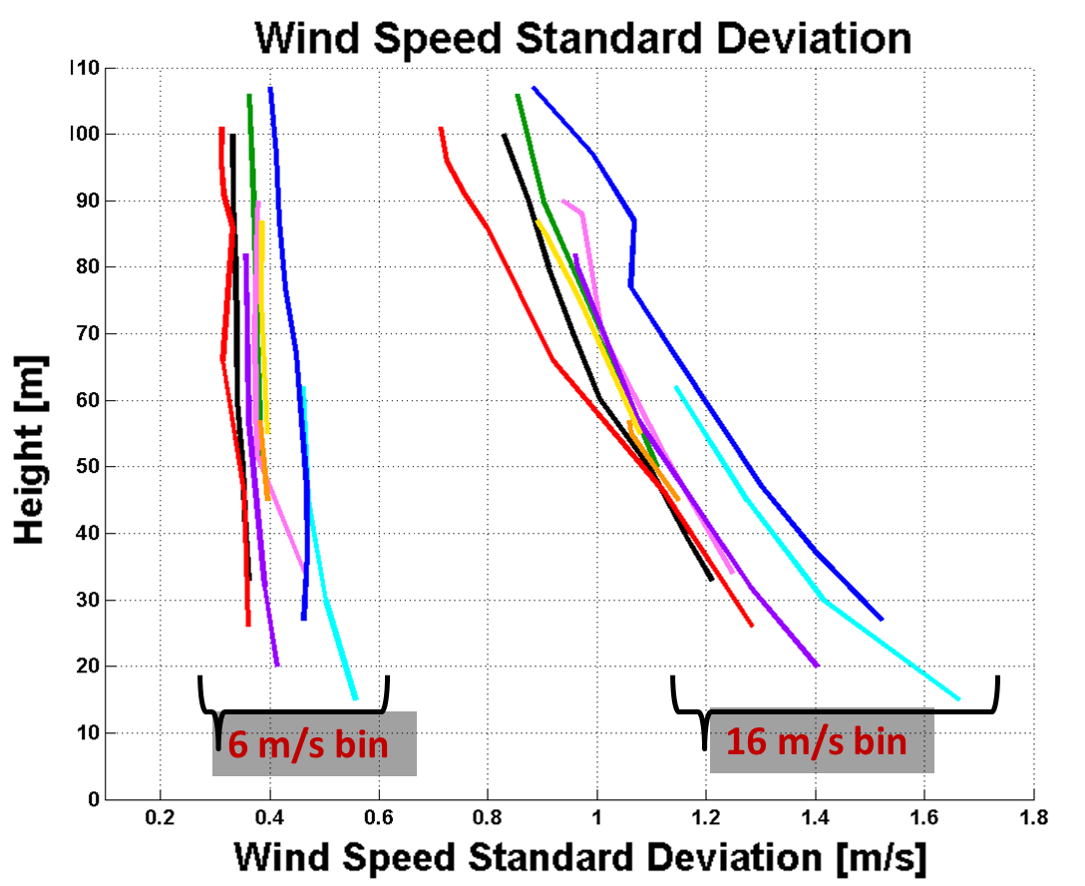
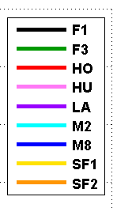
σ_{U} Vertical Profile Dependence on Speed
Nearly constant with height at low speeds: thermal mixing
Strong decrease w/ height at high speeds due to generation of turbulence at air-sea interface
Slightly higher values at sites closer to land
Very similar trend seen in TI

Slide 24
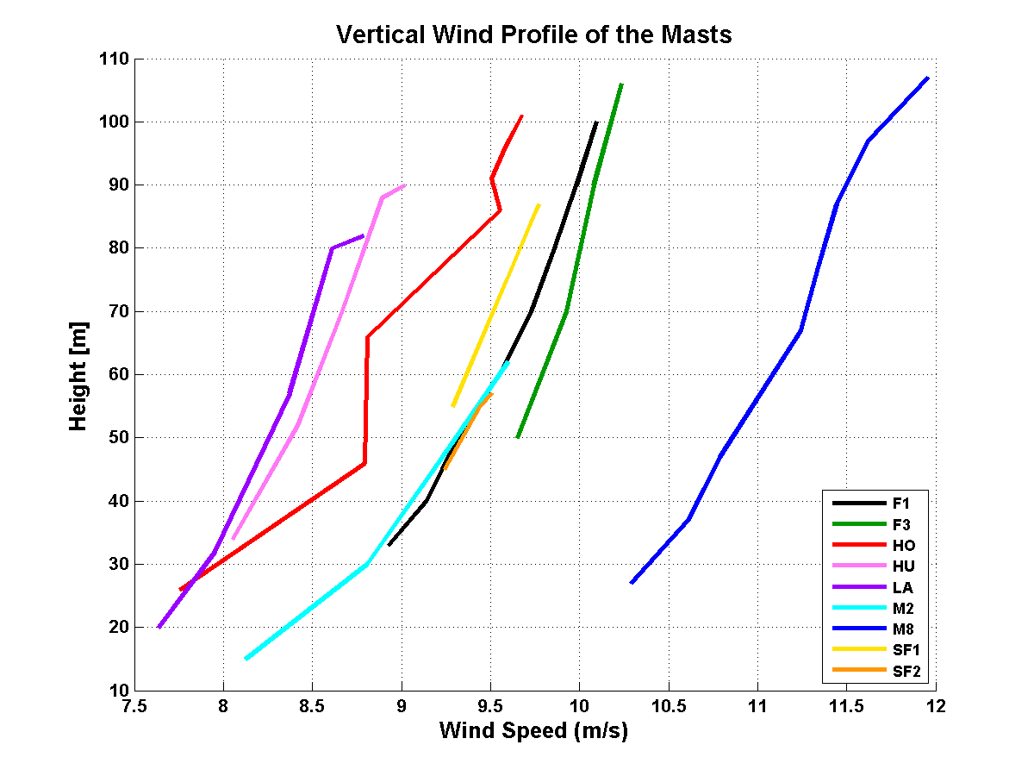
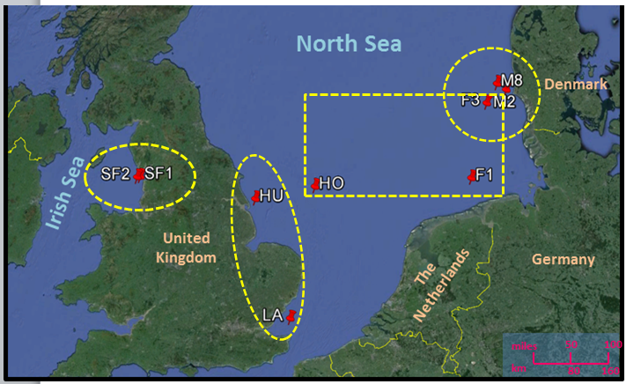
Regional Similarities – Vertical Wind Profile
One of key differentiable features between masts is proximity to shore
Similarities in average wind speed and average TI seen between masts within similar geographic region
Four regions demarked for the directional dependency analysis
Far Offshore Region – HO, F1, F3
East Coast UK – HU, LA
West UK / Irish Sea – SF1, SF2
West Coast DK – F3, M2, M8
Utilized Google Earth Measurement Tools
Notes:
Important to note that some differences could be due to inter-annual variability in general atmos flow.
HO’s slower profile likely due to data gap in winter months, when wind speeds are generally the largest.
The directional dependencies on TI were found here to be highly depedent on region, but rather similar within the regions. This is due to the influences of the local mesoscale meteorologcial conditions and geographical details. To show the differences between regions and similarities within regions, plots of TI vs theta are generated for each mast.
MAKE SURE CLEARLY EXPLAIN ALL OF THE FOLLOWING PLOTS WELL!!
Mention Google Earth’s use

Slide 25
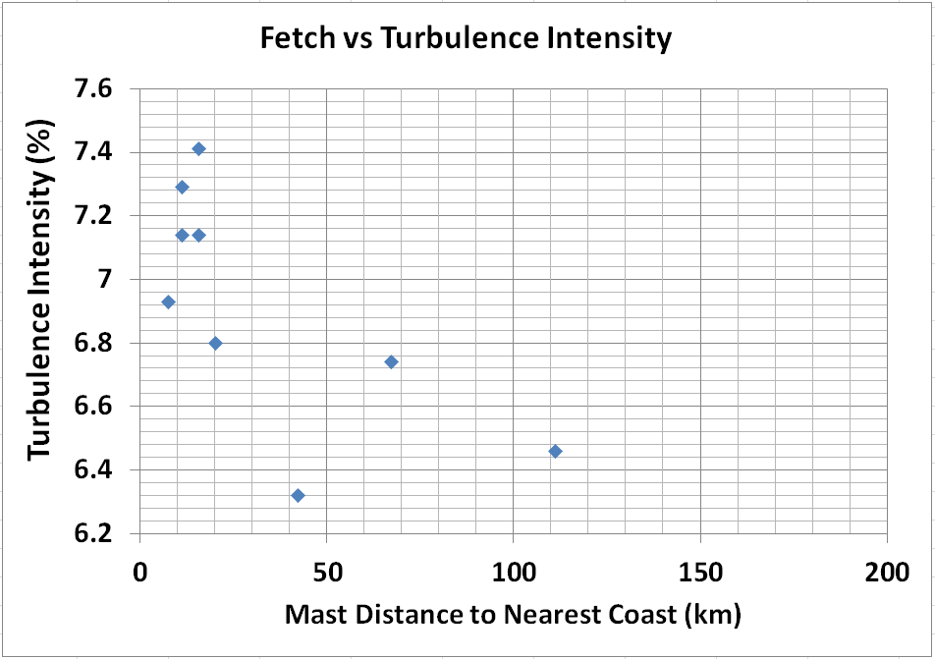
TI Not Necessarily Monotonic with Fetch
TI decreases with increasing fetch up until 40-50 km from coast → due to lower roughness offshore
Thereafter, TI increases slightly with increasing fetch → fully developed waves and larger swell
TI @ Height Closest to 50m
At all sites with swaths of fetch >100-200 km, the largest TI values were observed in these sectors. For sites when the nearest land < 40 km, additional factors contribute to max TI sectors.

Slide 26
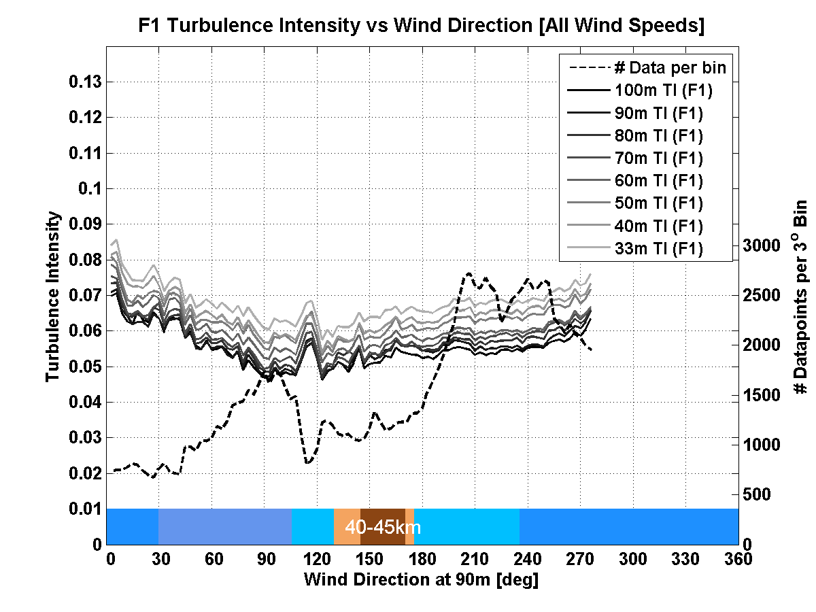
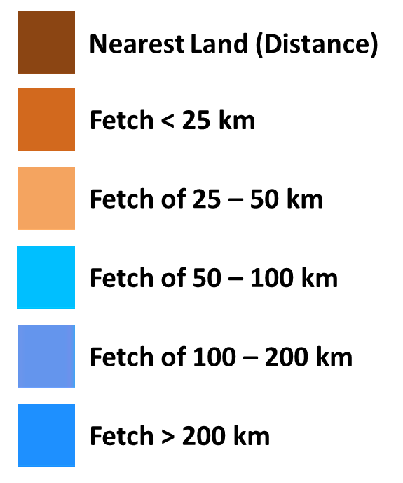
TI vs θ – Far Offshore Region (F1, F3, HO)
F1
Far Offshore is >40 km from coast
TI larger in sectors with fetch >200 km and lowest in land sectors
Also observed in other regions

Slide 27
Conclusions
σ_{U}, TI examined for dependencies on U, z, θ
Average TI at 50m ranged from 6.3 to 7.4%
σ_{U} increases with speed as expected, but not linearly as in IEC and after the turbulence transition, TI begins to increase with increasing wind speed, also contrary to the IEC standard
σ_{U} ,TI vs. U – strong similarity in trends indicating a nearly universal relationship across Northern Europe, especially at higher heights
Fetch found to be vital proxy for directional dependence on TI. TI decreases with increasing fetch until ~50km where it increased
TI predominantly is maximized in sectors with fetch >100-200 km (well-developed waves and swell)
At sites closer to shore, factors such as mountains and coastal orientation also lead to max TI sectors.
σ_{U ,} TI profiles (w/ height) show strong dependence on wind regime. At low speeds uniform with height, thermally driven turbulence; at high speeds, rapid decrease with z as distance from sea surface decreases

